Slide 1
Birds of the Forest

Slide 2
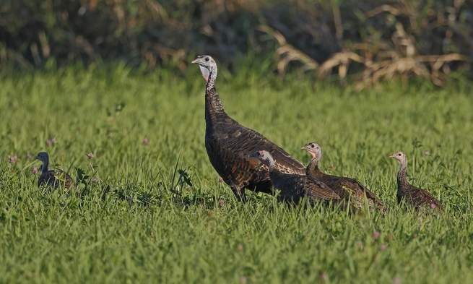

Slide 3
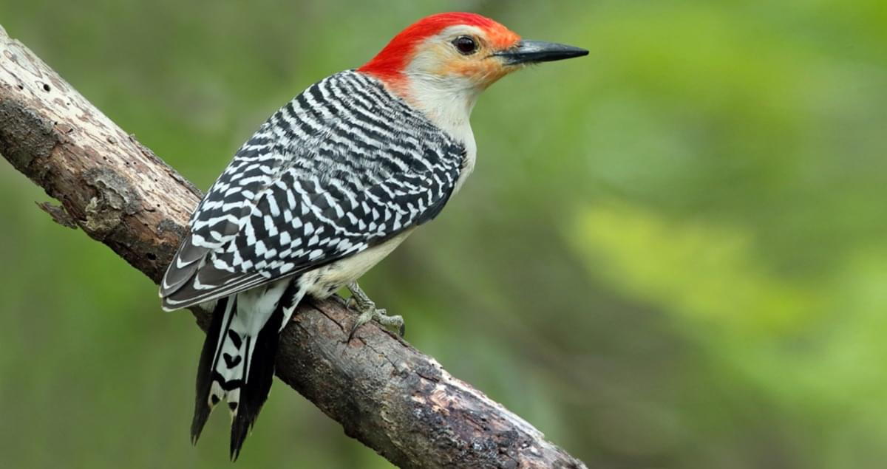


Slide 4
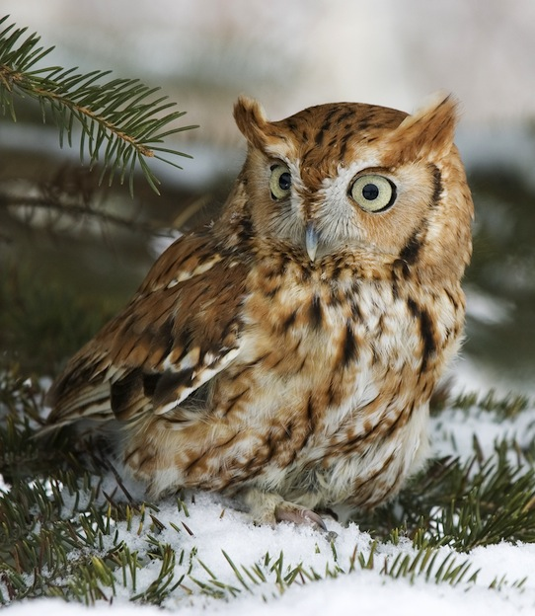
whinny
trill (bounce)

Slide 5
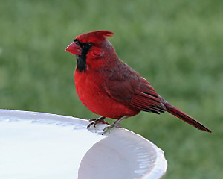

Slide 6
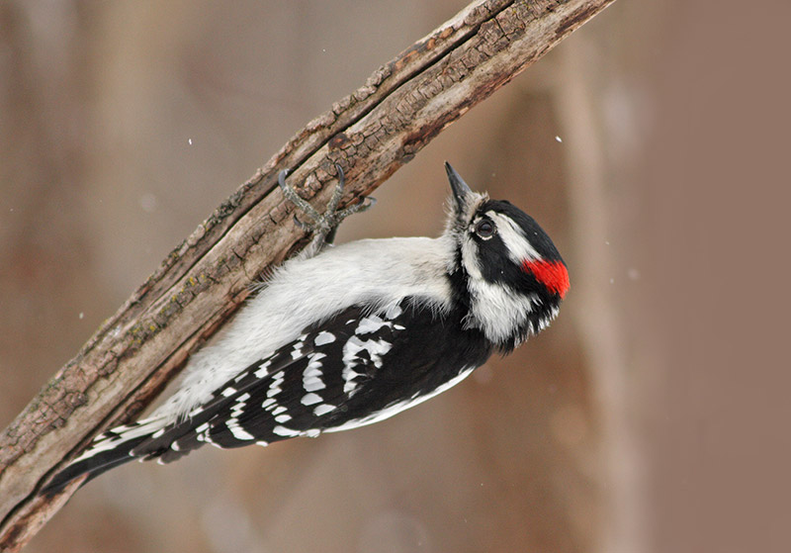

Slide 7
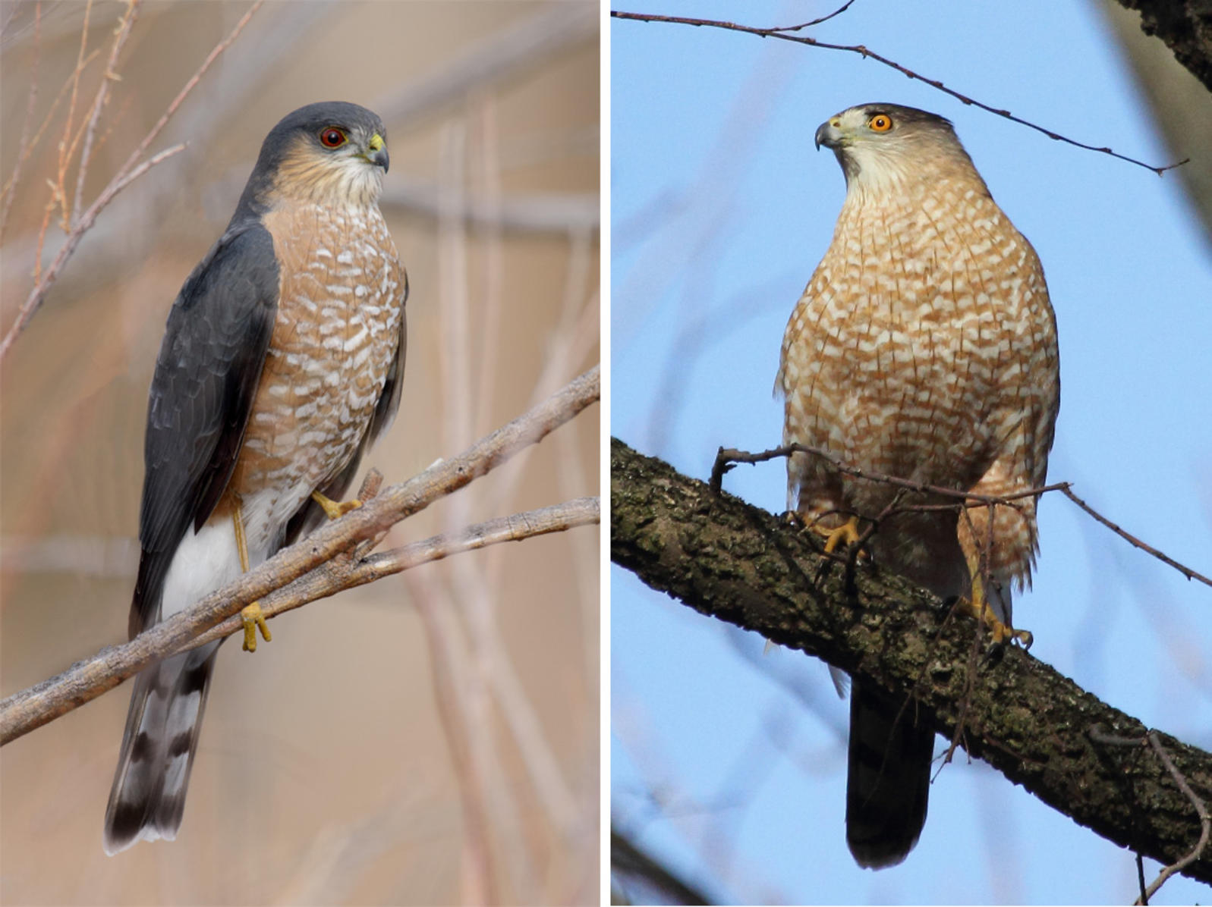

Slide 8
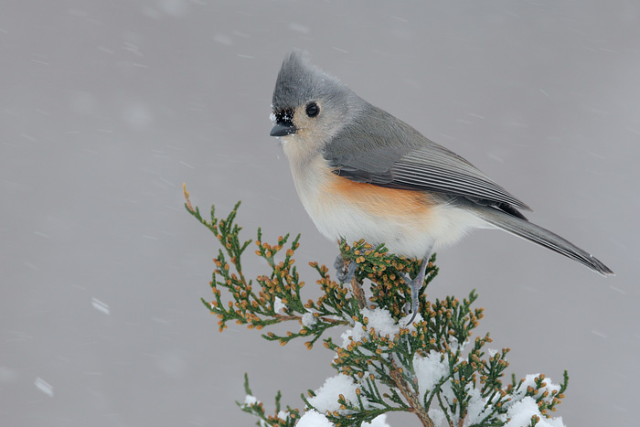

Slide 9
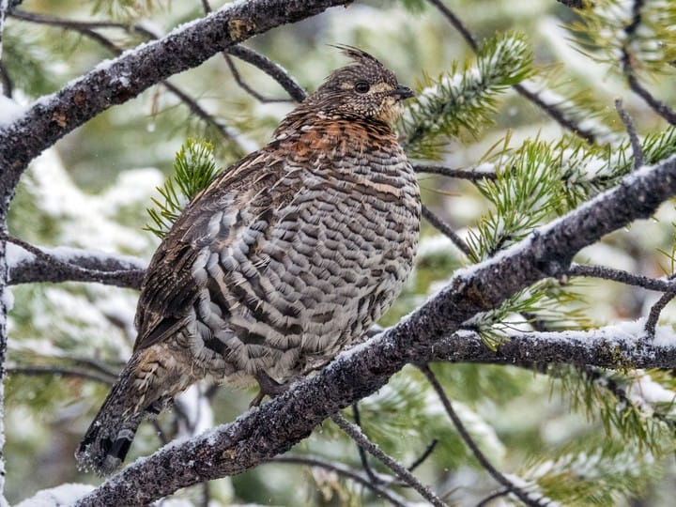
Female’s call
Male drumming

Slide 10
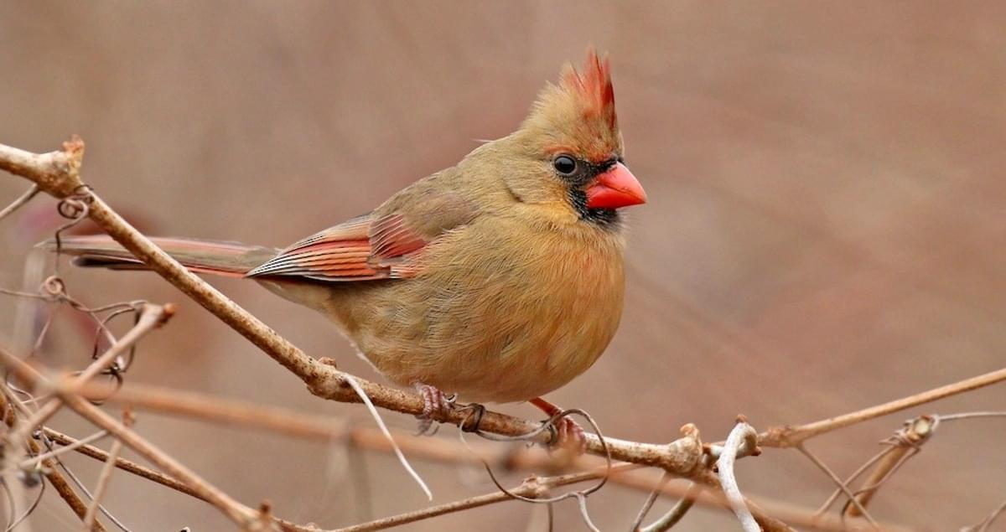

Slide 11
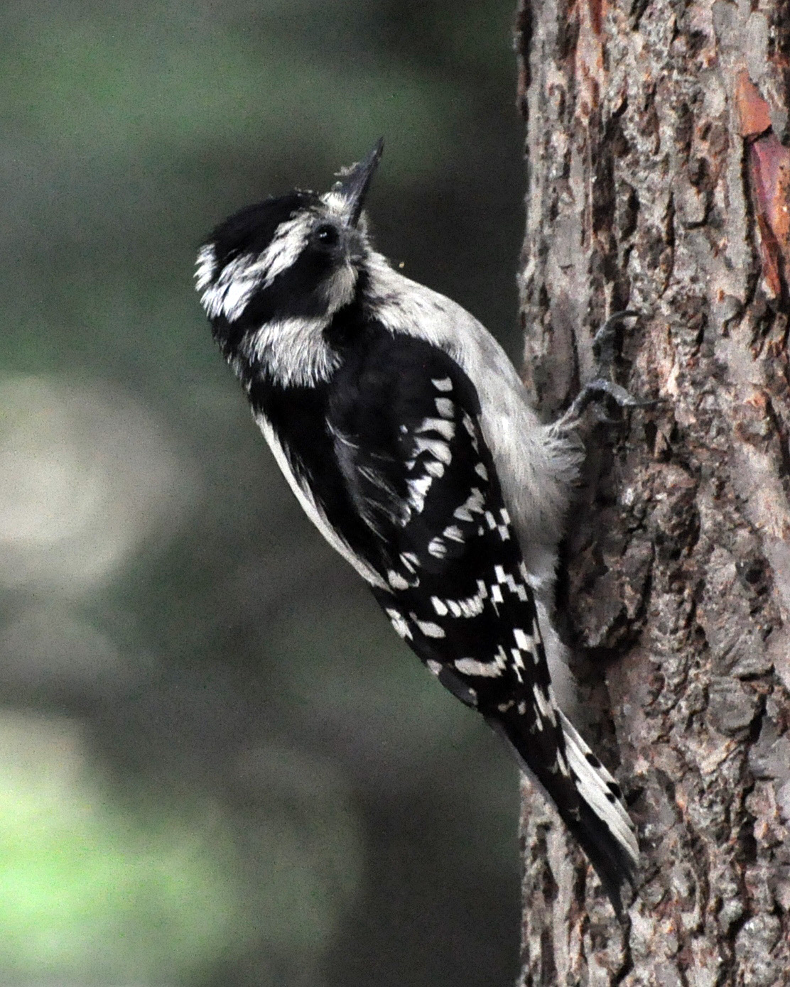

Slide 12
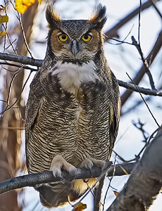

Slide 13
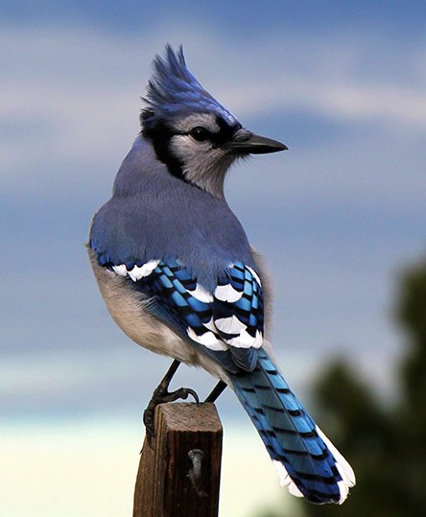

Slide 14
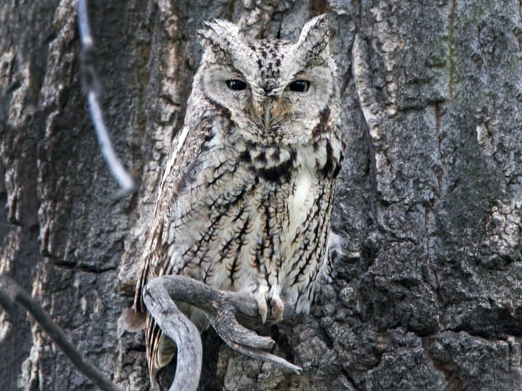

Slide 15
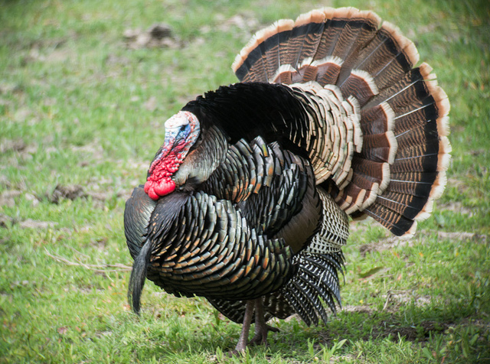

Slide 16
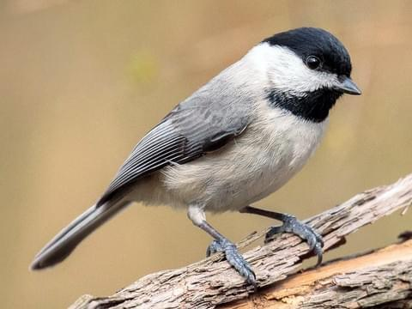

Slide 17
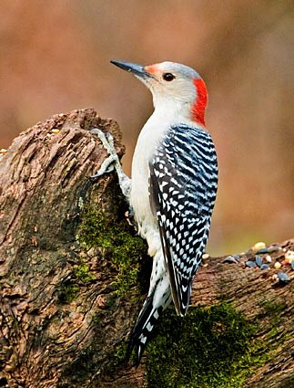

Slide 18
2 Wild turkey (hen w/ poults)
3 Red bellied woodpecker (male)
4 Screech owl (red phase)
5 Cardinal (male)
6 Downy woodpecker (male)
7 Sharp shinned hawk
8 Tufted titmouse
9 Ruffed grouse
10 Cardinal (female)
11 Downy woodpecker (female)
12 Great horned owl
13 Blue jay
14 Screech owl (gray phase)
15 Wild turkey (Tom or gobbler)
16 Black capped chickadee
17 Red bellied woodpecker (female)

